Slide 1


LIFELOGIX
WEB
APPLICATION
https://github.com/Lahcenw/LifeLogix
Presentation by
Lahcen EL MANNANI

Slide 2
Description
LifeLogix came to create an intuitive, all-in-one tool for personal growth and productivity. It is designed to move beyond simple to-do lists by integrating the core features necessary for genuine self-improvement:
Activities Tracker:
Log and measure the effort dedicated to various pursuits
Journal Description:
Capturing and reflecting on thoughts, feelings, and the key memorable moments of the day.
Goal Decomposition and Progress Visualization:
The ability to break down high-level, long-term goals into manageable, tracked sub-goals.

Slide 3
Target Audience
Benefits to the User
The primary target users are students, young professionals, and anyone managing busy schedule who needs to align their daily efforts with long term objectives.
The core audience is driven individuals who are motivated to track progress but lack a simple, unified digital tool
Users gain clarity on their long-term path, accountability through active tracking, and the motivation that comes from visualizing their incremental progress toward major goals. The application empowers users to manage their life actively rather than reactively.

Slide 4
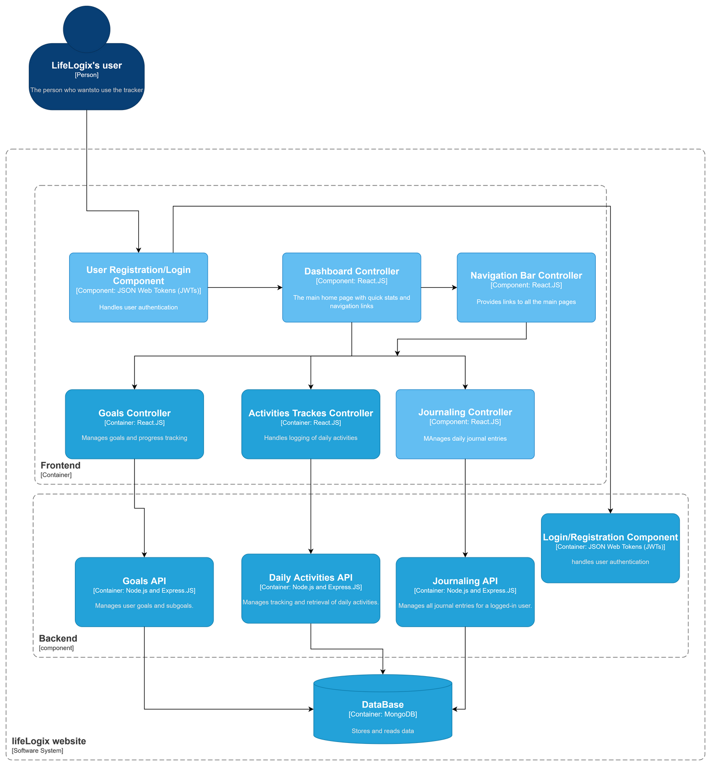
Components Diagram

Slide 5
Technological Choices
Key Features
Frontend: Next.js (React) for a fast, component-based user interface, and Tailwind CSS for responsive, utility-first styling.
Backend: Node.js with Express.js for the API server.
Database: MongoDB (NoSQL) for flexible, scalable data storage of journals, activities, and complex goal structures.
Secure User Authentication.
Goal Management System.
Personal Journaling.
Live Activities Tracking.
Responsive UI

Slide 6
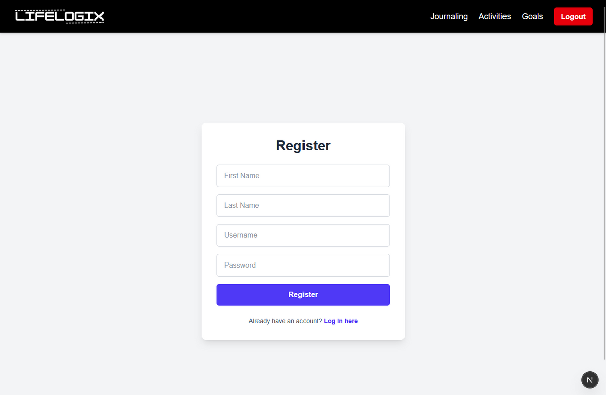
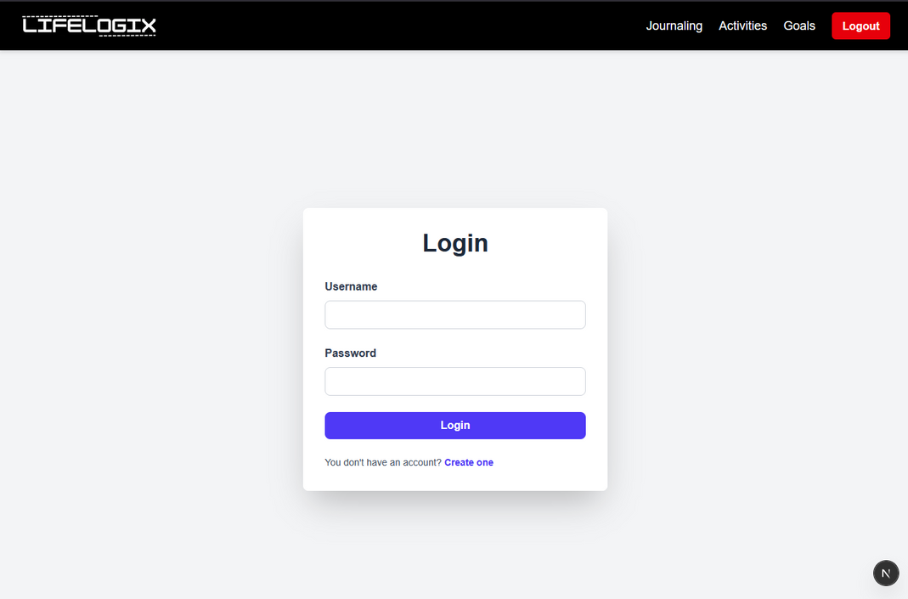
Screenshots: Login and Registration Page
User can create an account to access his own profile
Once created, username and password are used for log in

Slide 7
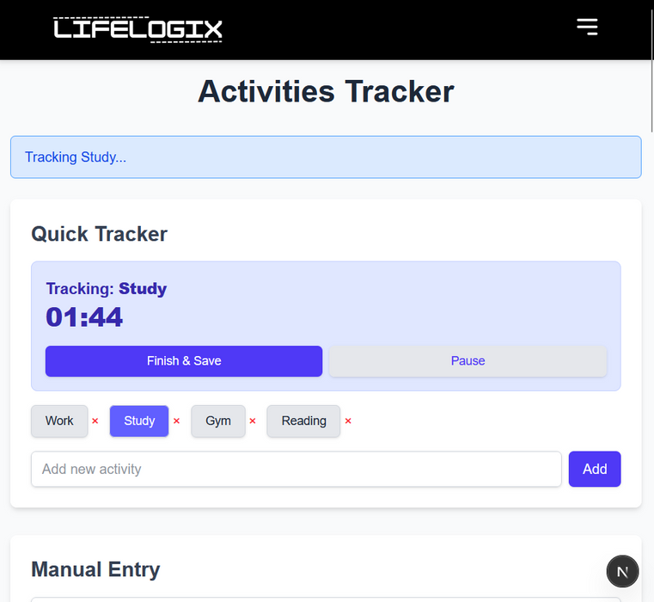
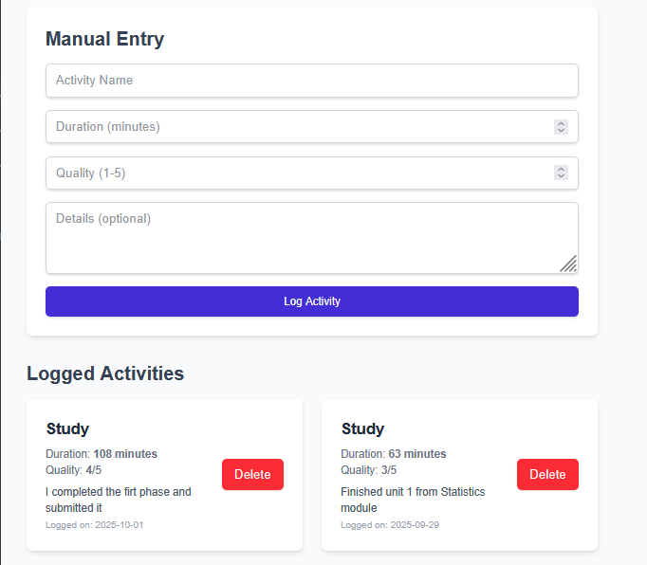
Screenshots: Activities Page
input elements are the name of the activity, a detail description, quality measure.
All logged activities can be showed below the manual entry section
User can choose to start the timer of either a defined
activity, or add a new one

Slide 8
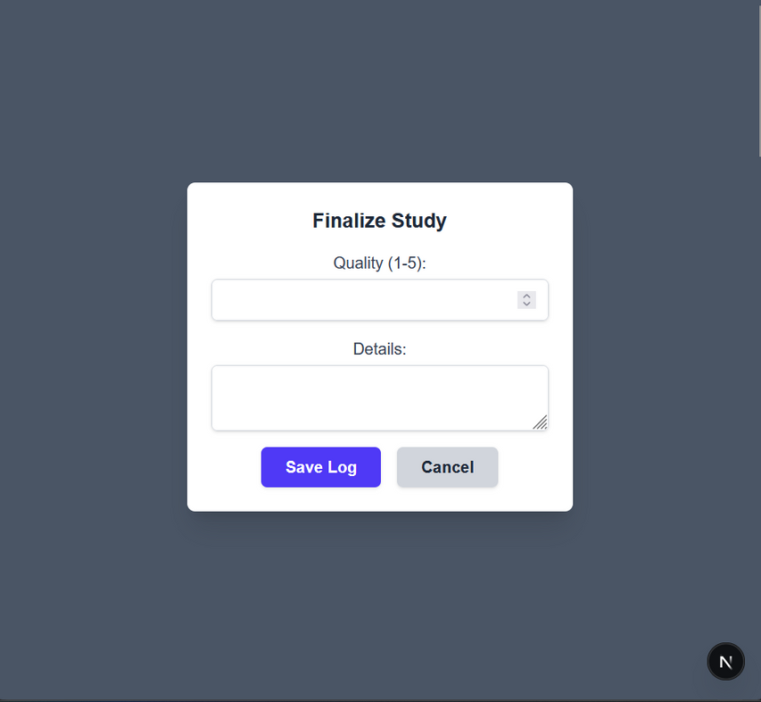
Screenshots: Activities Page
After clicking “Finish and Save” to save the tracked activity, a pop up shows up to enter the quality measure of the activity from 1 to 5, and optional details if needed

Slide 9
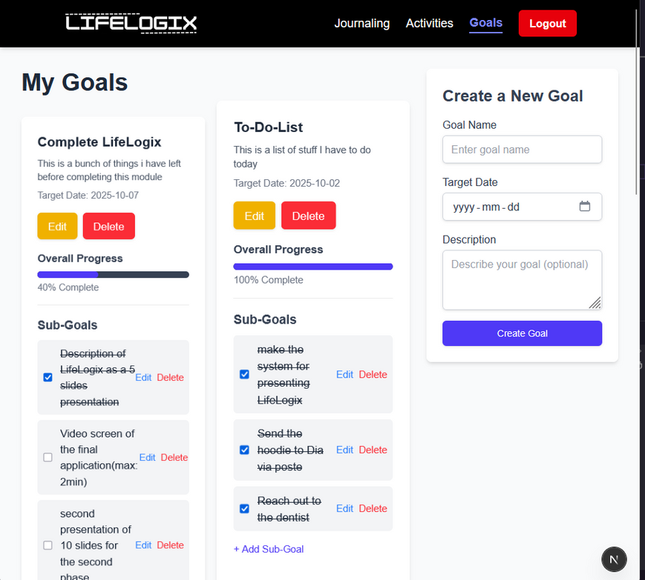
Screenshots: Goals Page
In the Goals page, one can create a new goal decomposed into sub goals, a progression bar is there to help the users see how much they reached from their goal

Slide 10
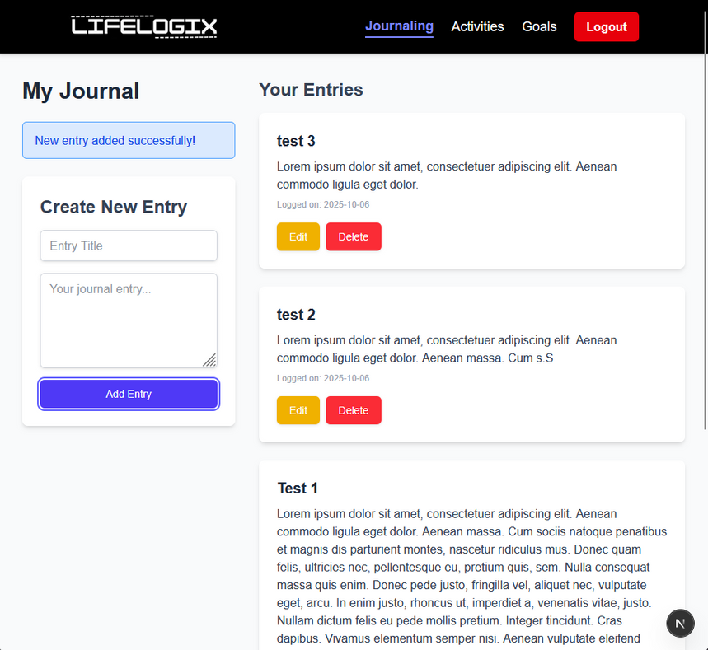
Screenshots: Journaling Page
The user can do journaling as a daily basis, to create a journal the user should enter a title for it, then start journaling in the description field, “Add Entry” to log the journal
The project was implemented as proposed.

Slide 11
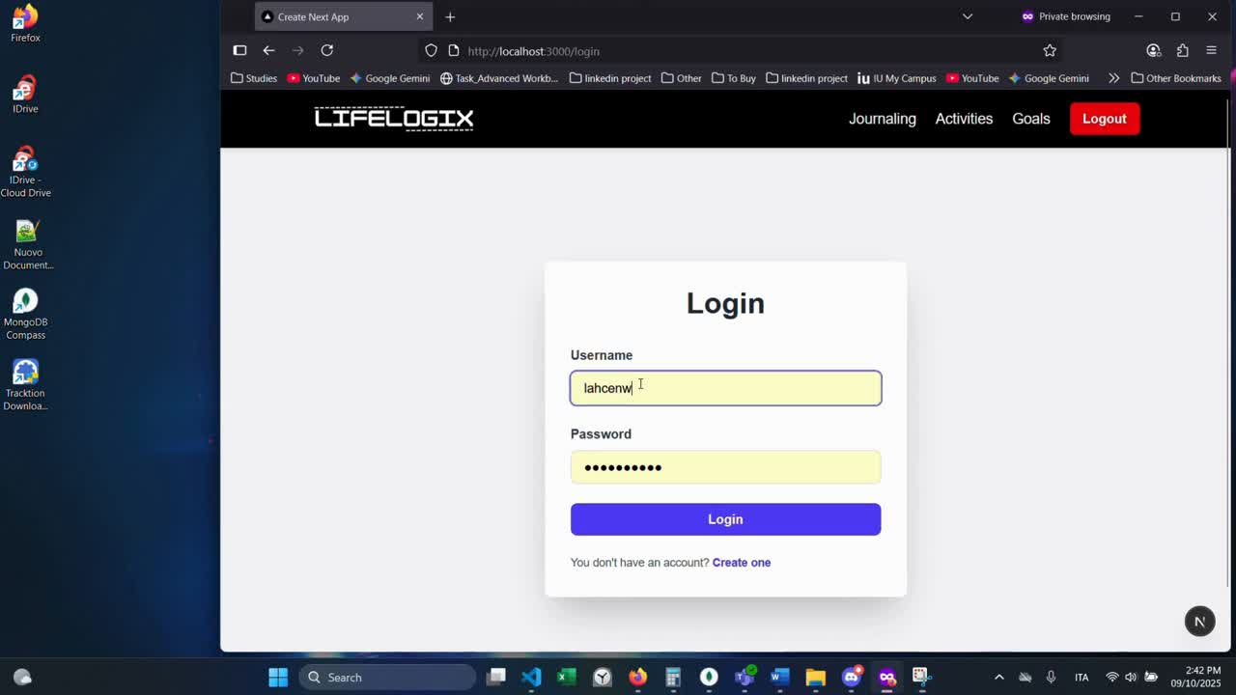
Screencast video of the application

